Slide 1
Big Data Analytics Symposium - Fall 2018
Analytics Project: Quantitative Analysis of Crime Incidents in the City of Chicago, IL using Data Analytics Techniques
Team: Daniel Rivera & Alisha Sawant
Abstract: By combining different data sources, the analytic will extract information that is correlated to the pattern of crime incidents in Chicago. Demographics, train ridership and traffic data, and business licenses in the areas were considered.

Slide 2
Quantitative Analysis of Crime Incidents in the City of Chicago, IL using Data Analytics Techniques
Motivation
Who are the users of this analytic? - Police Department of Chicago
Who will benefit from this analytic? - Police Department of Chicago & the residents of Chicago
Why is this analytic important?
This analytic can be used to anticipate the occurrence of certain types of crimes within the community areas of a Chicago. With this information, the police can increase the number of policemen on patrol and the patrol frequency in those areas.

Slide 3
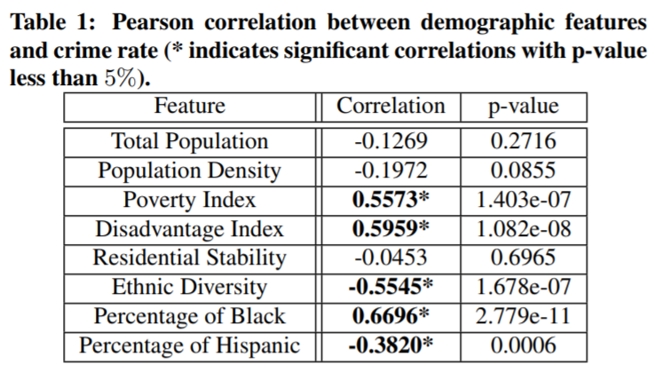
Quantitative Analysis of Crime Incidents in the City of Chicago, IL using Data Analytics Techniques
Goodness
What steps were taken to assess the ‘goodness’ of the analytic?
(Source: Graif C, Kifer D, Li Z, Wang H. Crime Rate Inference with Big Data. Available at https://www.kdd.org/kdd2016/papers/files/adp1044-wangA.pdf)
According to a previous analysis performed on the Chicago Crime dataset, poverty index is one of the demographic factors that exhibits a significant correlation to the number of crime incidents in the city.
Our results exhibit similar characteristics, so we have reason to believe that the analysis is trustworthy.

Slide 4
Quantitative Analysis of Crime Incidents in the City of Chicago, IL using Data Analytics Techniques
Data Sources
Name: Crimes - 2001 to present
Description: Reflects reported incidents of crime that occurred in the City of Chicago from 2001 to present.
Size of data: 1.7 GB
Name: Census Community Data
Description: A combination of multiple datasets giving information about age, ethnicity and economic demographics.
Size of data:
Name: Train Data – ‘L’ Station Entries
Description: Shows daily totals of ridership, by station entry, for each 'L' station dating back to 2001.
Size of data:

Slide 5
Quantitative Analysis of Crime Incidents in the City of Chicago, IL using Data Analytics Techniques
Data Sources (contd…)
Name: Chicago Traffic Tracker
Description: Contains the historical estimated congestion for 1270 traffic segments, in selected time periods from August 2011 to May 2018.
Size of data: 640 MB
Name: Business Licenses
Description: Business licenses issued by the Department of Business Affairs and Consumer Protection in the City of Chicago from 2002 to the present.
Size of data: 300 MB

Slide 6
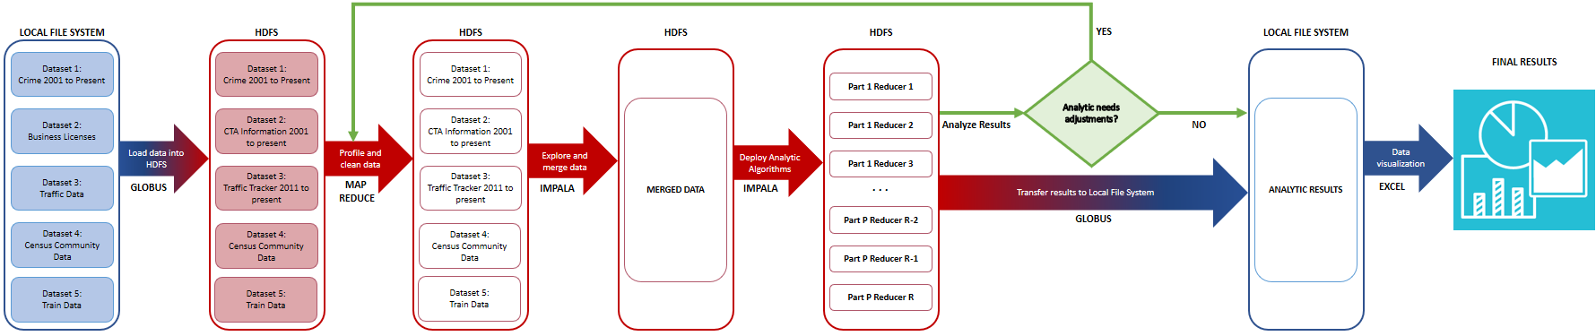
Quantitative Analysis of Crime Incidents in the City of Chicago, IL using Data Analytics Techniques
Design Diagram
Platform(s) on which the analytic ran:
NYU HPC Cluster - Dumbo

Slide 7
Quantitative Analysis of Crime Incidents in the City of Chicago, IL using Data Analytics Techniques
Results
1. Demographic factors, such as income below poverty level, repeatedly appear as highly correlated to several crime types in most community areas.
2. The number of public transportation buses within the city exhibits a high correlation with theft crime incidents.
3. Certain combinations of demographic factors and community areas exhibit a significant negative correlation with crime incidents.

Slide 8
Quantitative Analysis of Crime Incidents in the City of Chicago, IL using Data Analytics Techniques
Results
Factor | Crime Type | Community Area | Correlation
Income in the past 12 months below poverty level | Total | 00 | 0.8319
Public transportation buses | Theft | 00 | 0.8454
Average traffic speed | Prostitution | 57 | 0.8117
Income below poverty level: male 55 to 64 years | Total | 66 | -0.8706
Income below poverty level: female 55 to 64 years | Total | 66 | -0.8600

Slide 9
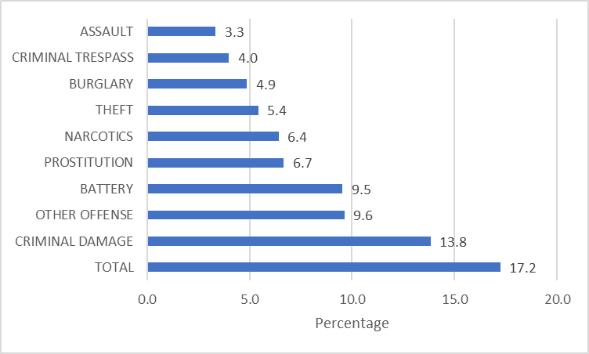
Quantitative Analysis of Crime Incidents in the City of Chicago, IL using Data Analytics Techniques
Results
Top 10 Crime Types by Percentage with High Correlations

Slide 10
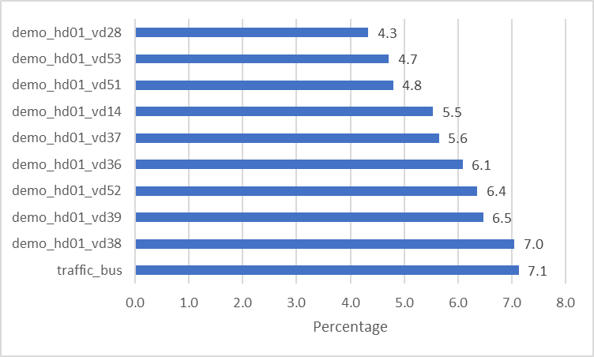
Quantitative Analysis of Crime Incidents in the City of Chicago, IL using Data Analytics Techniques
Results
Top 10 Factors by Percentage with High Correlations

Slide 11
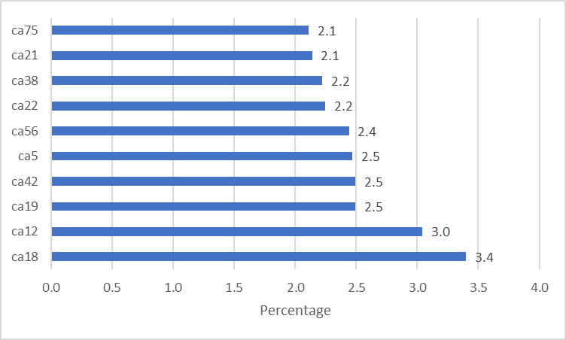
Quantitative Analysis of Crime Incidents in the City of Chicago, IL using Data Analytics Techniques
Results
Top 10 Community Areas by Percentage with High Correlations

Slide 12
Quantitative Analysis of Crime Incidents in the City of Chicago, IL using Data Analytics Techniques
Obstacles
1. Mapping the location information (latitude, longitude) to the corresponding community areas.
Using the Socrata Open Data API (SODA) we were able to query a dataset that includes the geometry of all the community areas:
String w = String.format("intersects(the_geom, '%s')", point);
SoqlQuery query = new SoqlQueryBuilder()
.addSelectPhrase("area_numbe")
.setWhereClause(w)
.build();
Connecting to the API was a time-consuming process, so making use of the parallelized computation capabilities of MapReduce was crucial to complete the task within a reasonable time (next slide)

Slide 13
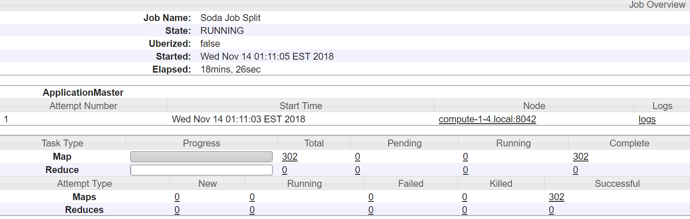
Quantitative Analysis of Crime Incidents in the City of Chicago, IL using Data Analytics Techniques
Obstacles

Slide 14
Quantitative Analysis of Crime Incidents in the City of Chicago, IL using Data Analytics Techniques
Summary
Crime is influenced by multiple factors that may be complex and unsuspected.
Positively correlated factors: take action towards minimizing them.
Negatively correlated factors: take action towards extrapolating them to other areas.
Future work: time series for causality analysis and forecasting.

Slide 15
Quantitative Analysis of Crime Incidents in the City of Chicago, IL using Data Analytics Techniques
References
Wang, Hongjian, et al. "Crime rate inference with big data." Proceedings of the 22nd ACM SIGKDD international conference on knowledge discovery and data mining. ACM, 2016.
Zhao, Xiangyu, and Jiliang Tang. "Crime in Urban Areas:: A Data Mining Perspective." ACM SIGKDD Explorations Newsletter 20.1 (2018): 1-12.
Williams, Matthew L., Pete Burnap, and Luke Sloan. "Crime sensing with big data: The affordances and limitations of using open-source communications to estimate crime patterns." The British Journal of Criminology 57.2 (2017): 320-340.
Pramanik, Md Ileas, et al. "A framework for criminal network analysis using big data." e-Business Engineering (ICEBE), 2016 IEEE 13th International Conference on. IEEE, 2016.

Slide 16
Quantitative Analysis of Crime Incidents in the City of Chicago, IL using Data Analytics Techniques
Thank you!

